Slide 1
Working with Time Series Data
Introduction to time series data
Indexing and plotting time series data

Slide 2
Section 1: Introduction to Time Series Data
What is a time series?
Characteristics of a time series
Example of time series data
Loading time series data - simple
Loading time series data - better
Getting a handle onto the DataFrame column

Slide 3

What is a Time Series?
According to Wiki:
A time series is a series of data points indexed (or listed or graphed) in time order.
Most commonly, a time series is a sequence taken at successive equally spaced points in time.
Examples of time series are heights of ocean tides, counts of sunspots, and the daily closing value of the Dow Jones index.
Time series analysis comprises methods for analysing time series data in order to extract meaningful statistics and other characteristics of the data.
Time series forecasting is the use of a model to predict future values based on previously observed values.

Slide 4
Characteristics of a Time Series
Time dependence
The data-points in a TS are time-dependent
Trends
TS data-points can show an overall increasing or decreasing trend
E.g. over a long period, the population of the world is increasing
Seasonality
TS data-points can show a repeating pattern over a time frame
E.g. the sales of ice cream follows a general annual pattern

Slide 5
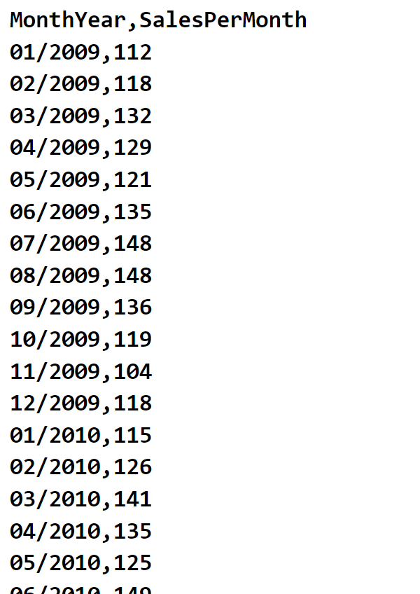
Example of Time Series Data
In this chapter we'll work on time series (TS) data that shows the product sales each month for about a decade
Sales.csv

Slide 6
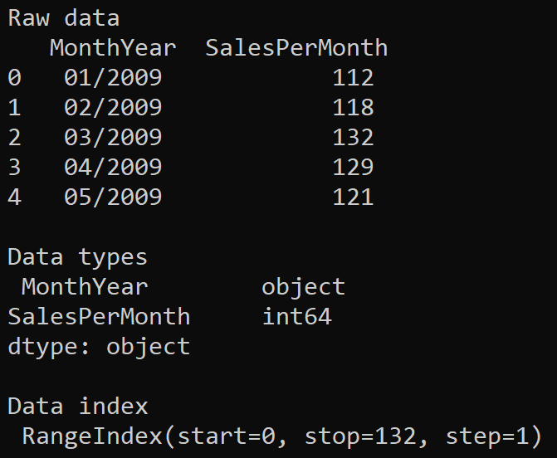
Loading TS Data - Simple
Let's load the TS data into a DataFrame
Note the data type of the MonthYear column is just object
Note the index is just a number range (0…132)
data = pd.read_csv('Sales.csv')
print('\nRaw data\n', data.head())
print('\nData types\n', data.dtypes)
print('\nData index\n', data.index)
Ex01-LoadRawData.py

Slide 7
Loading TS Data - Better (1 of 2)
The following code is an improvement in two respects:
We parse the MonthYear column as date values
We specify the MonthYear column as the index column for the DataFrame - this is a requirement for Pandas TS processing
data = pd.read_csv('Sales.csv',
parse_dates=['MonthYear'],
index_col='MonthYear',
date_format='%m/%Y')
print('\nParsed data\n', data.head())
print('\nData types\n', data.dtypes)
print('\nData index\n', data.index)
Ex02-LoadAndParseData.py

Slide 8
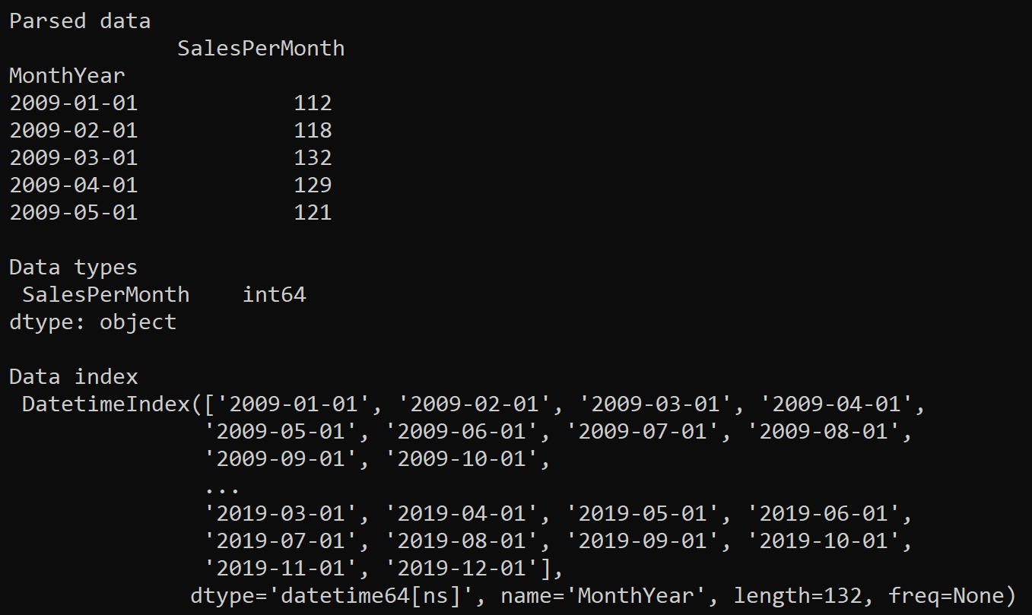
Loading TS Data - Better (2 of 2)
Here's the output from the code in the previous slide
The DataFrame is now indexed by the MonthYear column
datetime64 is a Pandas array type
that supports datetime functionality

Slide 9
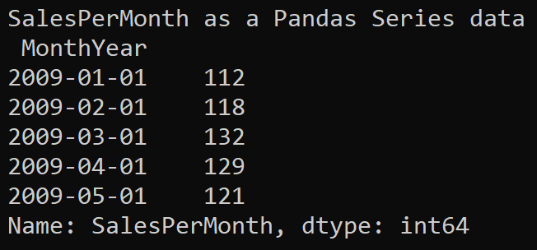
Getting a Handle onto the DataFrame Column
For convenience, it's handy to store a reference to the DataFrame column in a separate variable
data = pd.read_csv('Sales.csv',
parse_dates=['MonthYear'],
index_col='MonthYear',
date_format='%m/%Y')
ts = data['SalesPerMonth']
print('\nSalesPerMonth as a Pandas Series data\n', ts.head())
Ex03-GetColumn.py

Slide 10
Section 2: Indexing and Plotting Time Series Data
Indexing into a TS to get a particular value
Indexing into a TS to get a range of values
Indexing into a TS to get data from a start date
Indexing into a TS to get data up to an end date
Indexing into a TS to get data for an entire year
Plotting a TS

Slide 11

Indexing into a TS to Get a Particular Value
Remember the TS data is indexed by date/time
Therefore you can get the value at a particular date/time index
There are two ways to specify the date/time index…
As a string literal
As a Pandas datetime object
…
salesFeb2009 = ts['2009-02-01']
salesMar2009 = ts[datetime(2009, 3, 1)]
print('Sales in Feb 2009:', salesFeb2009)
print('Sales in Mar 2009:', salesMar2009)
Ex04a-IndexIntoSeries.py

Slide 12
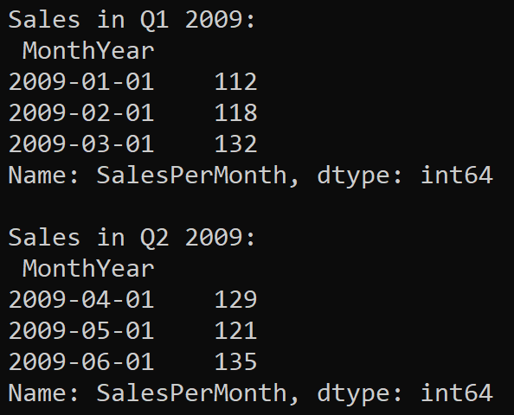
Indexing into a TS to Get a Range of Values
You can get a range of values from the TS series
[lowerIndex : upperIndex]
…
salesQuarterOne2009 = ts['2009-01-01' : '2009-03-01']
salesQuarterTwo2009 = ts[datetime(2009,4,1) : datetime(2009,6,1)]
print('\nSales in Q1 2009:\n', salesQuarterOne2009)
print('\nSales in Q2 2009:\n', salesQuarterTwo2009)
Ex04b-IndexIntoSeries.py

Slide 13
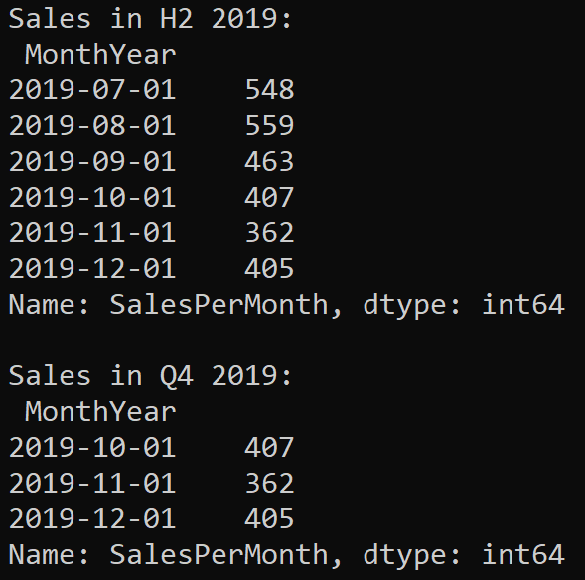
Indexing into a TS to Get Data from a Start Date
You can get data from a start date
[lowerIndex : ]
Ex04c-IndexIntoSeries.py
…
salesHalfTwo2019 = ts['2019-07-01' : ]
salesQuarterFour2019 = ts[datetime(2019,10,1) : ]
print('\nSales in H2 2019:\n', salesHalfTwo2019)
print('\nSales in Q4 2019:\n', salesQuarterFour2019)
Ex04c-IndexIntoSeries.py

Slide 14
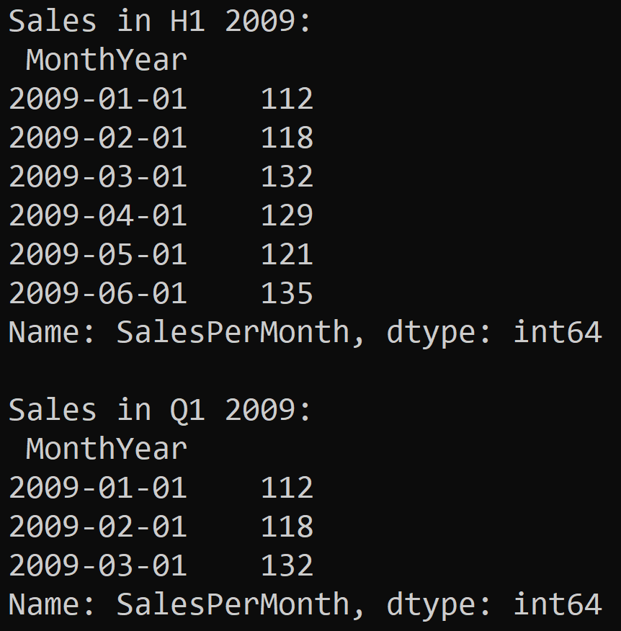
Indexing into a TS to Get Data up to an End Date
You can get data up to an end date
[ : upperIndex]
…
salesHalfOne2009 = ts[ : '2009-06-01']
salesQuarterOne2009 = ts[ : datetime(2009,3,1) ]
print('\nSales in H1 2009:\n', salesHalfOne2009)
print('\nSales in Q1 2009:\n', salesQuarterOne2009)
Ex04d-IndexIntoSeries.py

Slide 15
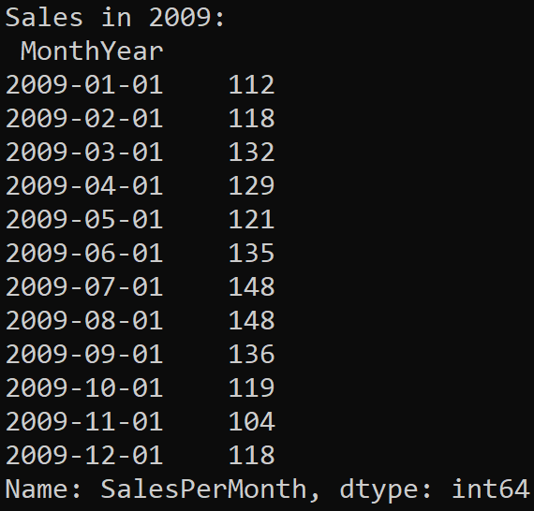
Indexing into a TS to Get Data for an Entire Year
You can get data for an entire year
Specify the year as the index
…
sales2009 = ts['2009']
print('\nSales in 2009:\n', sales2009)
Ex04e-IndexIntoSeries.py

Slide 16
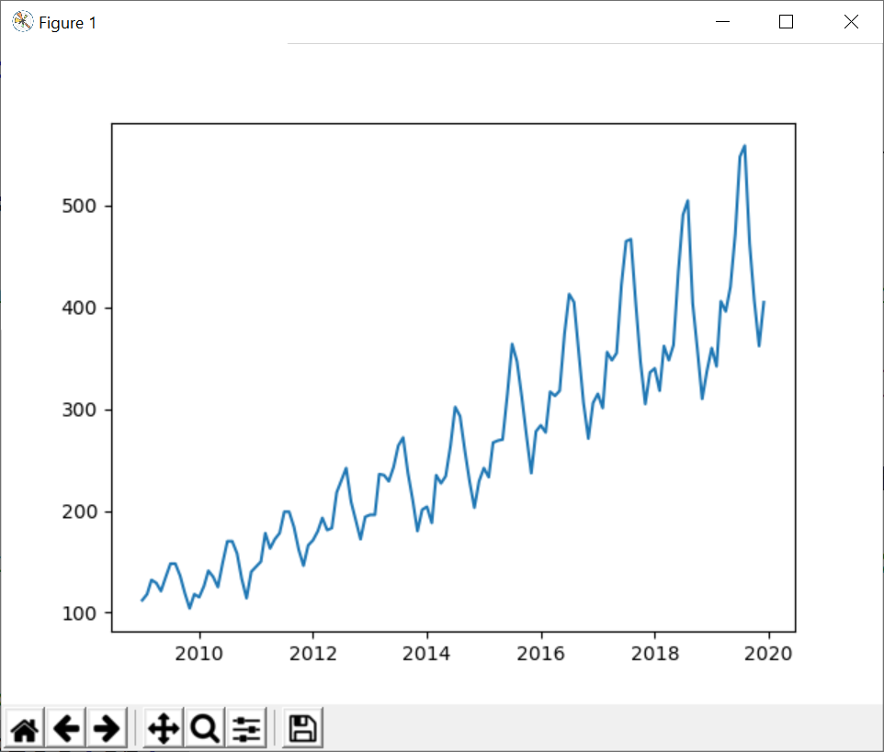
Plotting a TS
You can plot the TS using MatPlotLib
The x axis shows the date/time index values
The y axis shows the data point for each date/time
Note the following points:
The TS data shows a general increasing trend over time
There is some seasonality within a 12-month period
import matplotlib.pyplot as plt
…
plt.plot(ts)
plt.show()
Ex05-Plot.py

Slide 17
Summary
Introduction to time series data
Indexing and plotting time series data

